Slide 1
RAID
Originally, the term RAID was defined as redundant array of inexpensive disks, but now it usually refers to a redundant array of independent disks.
RAID storage uses multiple disks in order to provide fault tolerance, to improve overall performance, and to increase storage capacity in a system.
This is in contrast with older storage devices that used only a single disk drive to store data.
RAID allows you to store the same data redundantly (in multiple paces) in a balanced way to improve overall performance.
RAID disk drives are used frequently on servers but aren't generally necessary for personal computers.

Slide 2
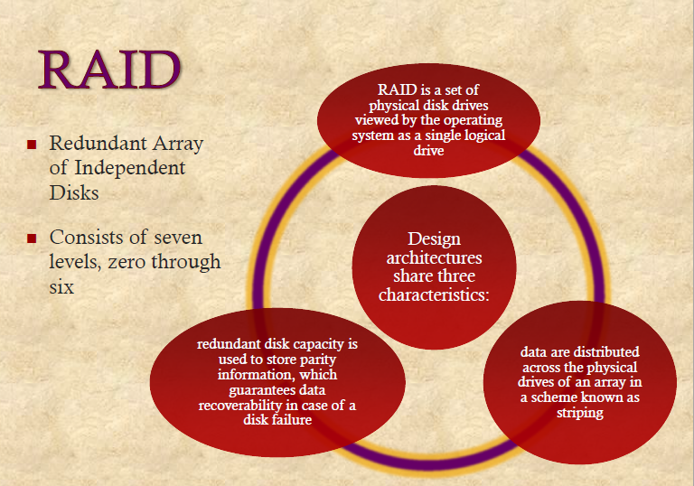


Slide 3
RAID
With RAID technology, data can be mirrored on one or more disks in the same array, so that if one disk fails, the data is preserved.
a technique known as striping (a technique for spreading data over multiple disk drives),
RAID also offers the option of reading or writing to more than one disk at the same time in order to improve performance.
In this arrangement, sequential data is broken into segments which are sent to the various disks in the array, speeding up throughput.

Slide 4
RAID (redundant array of independent disks)
Redundant array of inexpensive disks
Multiple disk database design
Not a hierarchy
7 levels (6 levels in common use)
Set of physical disk drives viewed by the OS as a single logical drive
Data are distributed across the physical drives of an array
Redundant disk capacity is used to store parity information => data recoverability
Improve access time and improve reliability

Slide 5
STANDARD RAID LEVELS
Level 0: Striped disk array without fault tolerance
Level 1:mirrored
Level 2: Error-correcting coding
Level 3: bit interleaved parity
Level 4: block level parity
Level 5: block distributed parity
Level 6: dual redundancy

Slide 6
RAID Level 0
Not a true member of the RAID family - does not include redundancy to improve performance.
User and system data distributed across all disks in the array in strips.
Imagine a large logical disk containing ALL data. This is divided into strips (physical blocks or sectors) that are mapped ‘round robin’ to the strips in the array.
A set of logically consecutive strips that maps exactly one strip to each array member is referred to as a stripe.
+ If two different I/O requests are pending for two different blocks of data – then there is a good chance that the data will be on different disks and can be serviced in parallel.
+ If a single I/O request is for multiple logically continuous strips – up to n strips can be handled in parallel.

Slide 7
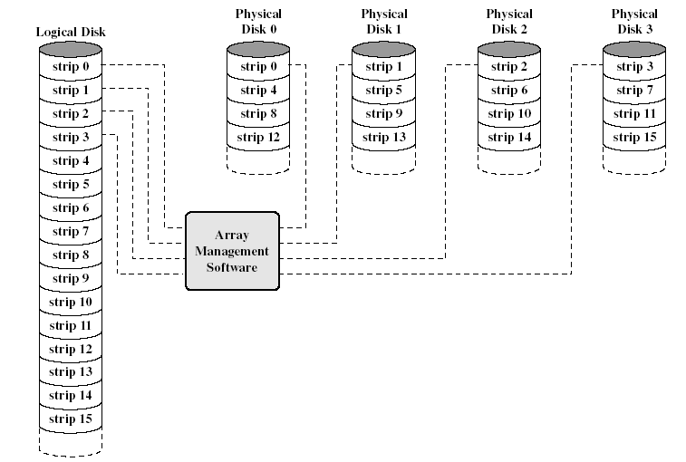
Data Mapping for RAID Level 0
This software may execute either in the disk sub system or in a host computer

Slide 8
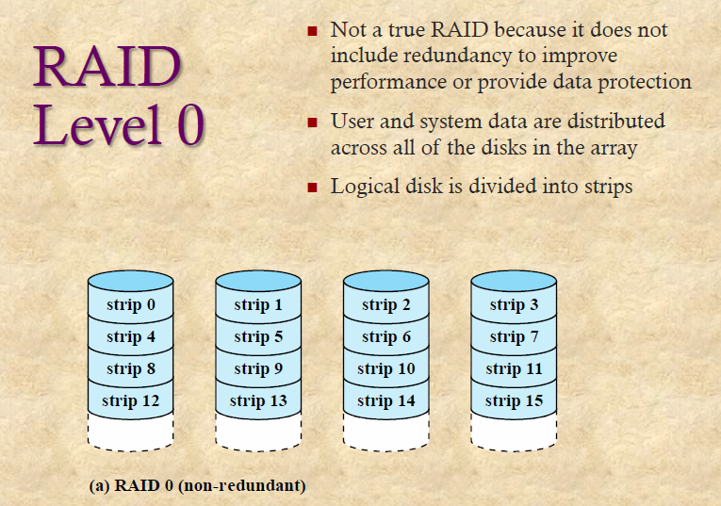

Slide 9
RAID Level 1
Redundancy achieved through duplicating all data.
Data stripping is similar to RAID level 0.
Each logic strip is mapped to two physical disks.
  Read request can be serviced from either of available 2 disks, which ever involves the minimum seek time and rotational latency
  Write request requires both disks to be updated – but this can be done in parallel. (Slower write dictates overall speed).
  Recover from failure is simple! (data may still be accessed from the second drive
Disadvantage:
  Cost
    requires twice the disk space
    Configuration is limited, so used only for system software and other highly critical files.
Improvement occurs if the application can split each read request so that both disk members participate

Slide 10
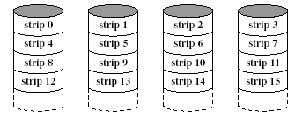
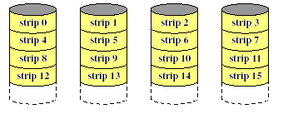
RAID Level 1 (Mirroring

Slide 11
RAID Level 2
Utilizes parallel access techniques - All disks participate in the execution of every I/O request.
Spindles of individual drives are synchronized so that each disk head is in the same position on each disk at any given time.
Data striping – very small strips (single byte or word).
Error correcting code is calculated across corresponding bits on each disk, and the code bits are stored in corresponding bit positions on multiple parity disks.
For Hamming Code – number of parity (redundant) disks is proportionate to the log of the number of data disks.
On a single read, all disks are simultaneously accessed. The requested data and the associated error correcting code are delivered to the array controller. Array controller can detect and fix single bit errors.
For write – all disks must be accessed.
Good choice – only for an environment in which many errors occur – therefore not used much (given high reliability if individual disks and disk drives).

Slide 12
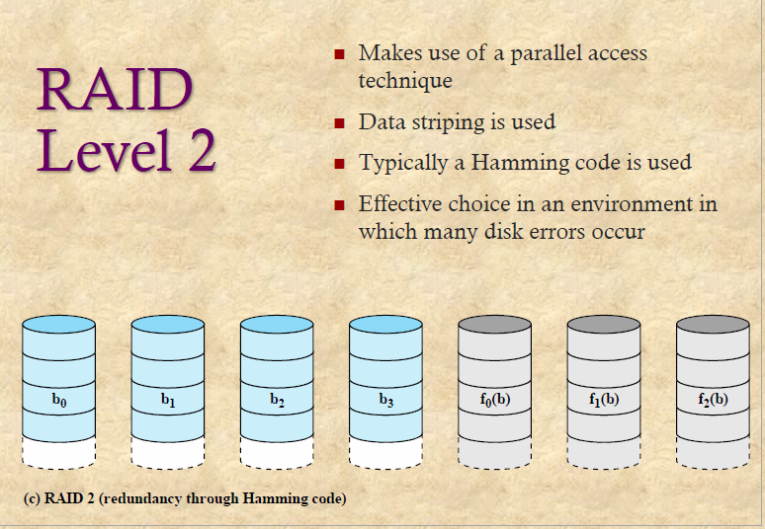

Slide 13
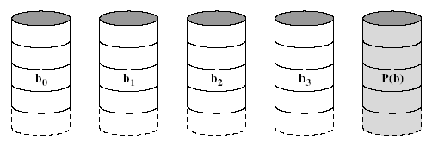
RAID Level 3(bit interleaved parity)
Similar to RAID 2 – parallel access with data distributed in small strips.
Requires only a single redundant disk because it uses a single parity bit for the set of individual bits in the same position on all of the data disks.
If drives X0-X3 contain data, and X4 contains parity bits.
X4(i) = X3(i) ⊕ X2(i) ⊕ X1(i) ⊕ X0(i)
Redundancy – in the case of disk failure, the data can be reconstructed.
If drive X1 fails – it can be reconstructed as:
X1(i) = X4(i) ⊕ X3(i) ⊕ X2(i) ⊕ X0(i)
Performance – can achieve high transfer rates, but only one I/O request can be executed at one time. (Better for large data transfers in non transaction-oriented environments).

Slide 14
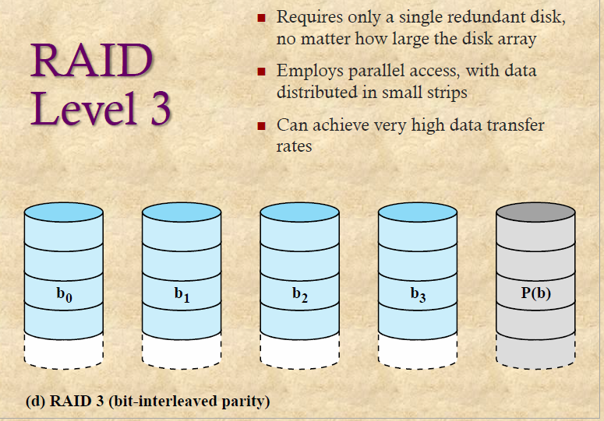

Slide 15
RAID Level 4( block level parity)
Each disk operates independently - Separate I/O requests satisfied in parallel.
Suitable for applications with high I/O request rates and NOT well suited for those requiring high data transfer rates.
Data striping. (Strips are larger than in lower RAIDs).
Bit-by-bit parity strip is calculated across corresponding strips on each data disk, and stored in corresponding strip on the parity disk.
Performance – write penalty when I/O request is small size. Write must update user data + corresponding parity bits.
X4(i) = X3(i) ⊕ X2(i) ⊕ X1(i) ⊕ X0(i)
If X1(i) is changed to X1’(i)
X4’(i) = X3(i) ⊕ X2(i) ⊕ X1’(i) ⊕ X0(i)
To calculate new parity, the old user data,new user data and old parity strips must be read. Then it can update these two strips with the new data and the newly calculated parity. Thus each strip write involves two reads and two writes.

Slide 16
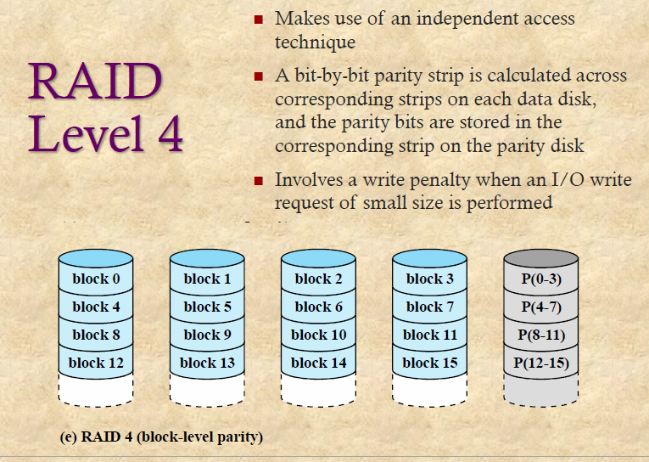

Slide 17
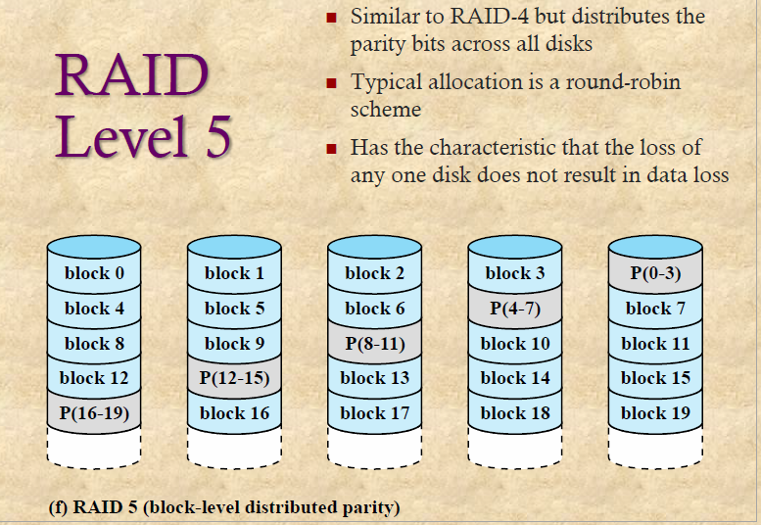
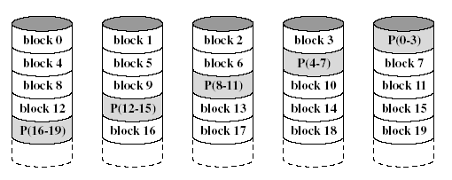
RAID Level 5( block distributed parity)
Same as RAID 4 – but parity strips are distributed across all disks.
Typical allocation uses round-robin.
For an n-disk array, the parity strip is on a different disk for the first n strips and the pattern then repeats.
Avoids potential bottleneck found in RAID 4.

Slide 18
RAID Level 6(dual redundancy)
Two different parity calculations are carried out and stored in separate blocks on different disks.
  Example: XOR and an independent data check algorithm => makes it possible to regenerate data even if two disks containing user data fail.
No. of disks required = N + 2 (where N = number of disks required for data).
Provides HIGH data availability.
Incurs substantial write penalty as each write affects two parity blocks.

Slide 19
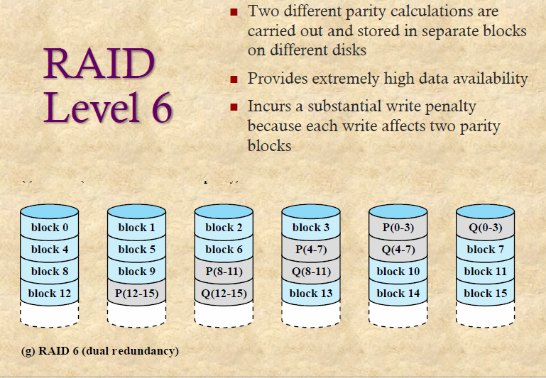

Slide 20
Comparison of RAID Levels
Category | Level | Description | I/O request rate (Read/Write) | Data Transfer Rate (Read/Write) | Typical application
Stripping | 0 | Nonredundant | large strips: excellent | small strips: excellent | applications requiring high performance for non-critical data
Mirroring | 1 | Mirrored | Good/Fair | Fair/fair | System drives; critical files
Parallel access | 2 | redundant via hamming code | poor | excellent
 | 3 | Bit-Interleaved parity | poor | excellent | large I/O request size applications, such as imaging, CAD
independent access | 4 | Block-interleaved parity | excellent/fair | fair/poor
 | 5 | Block-interleaved distributed parity | excellent/fair | fair/poor | high request rate, read intensive, data lookup
 | 6 | block-interleaved dual distributed parity | excellent/poor | fair/poor | applications requiring extreamly high availability

Slide 21
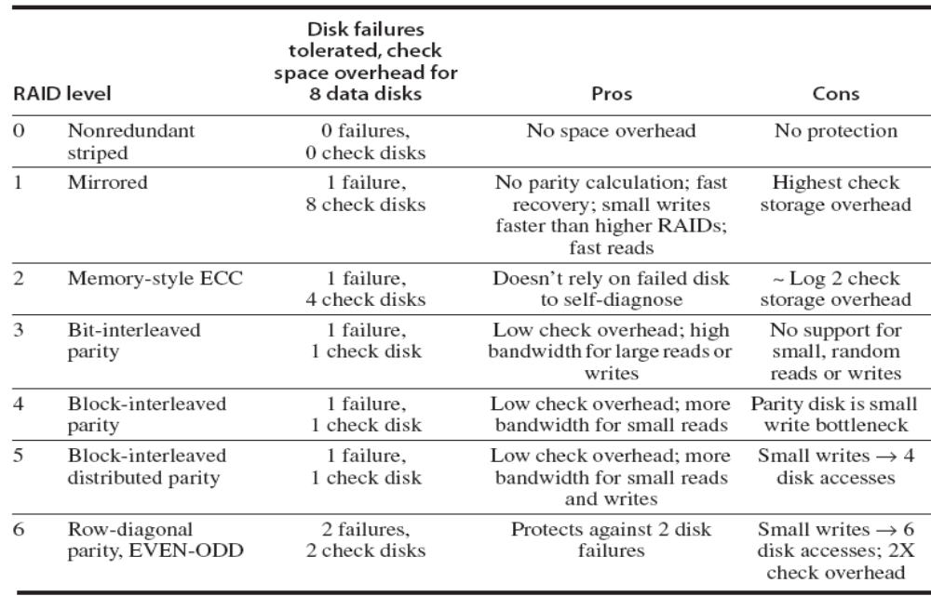
Comparison of RAID Levels

